Slide 1
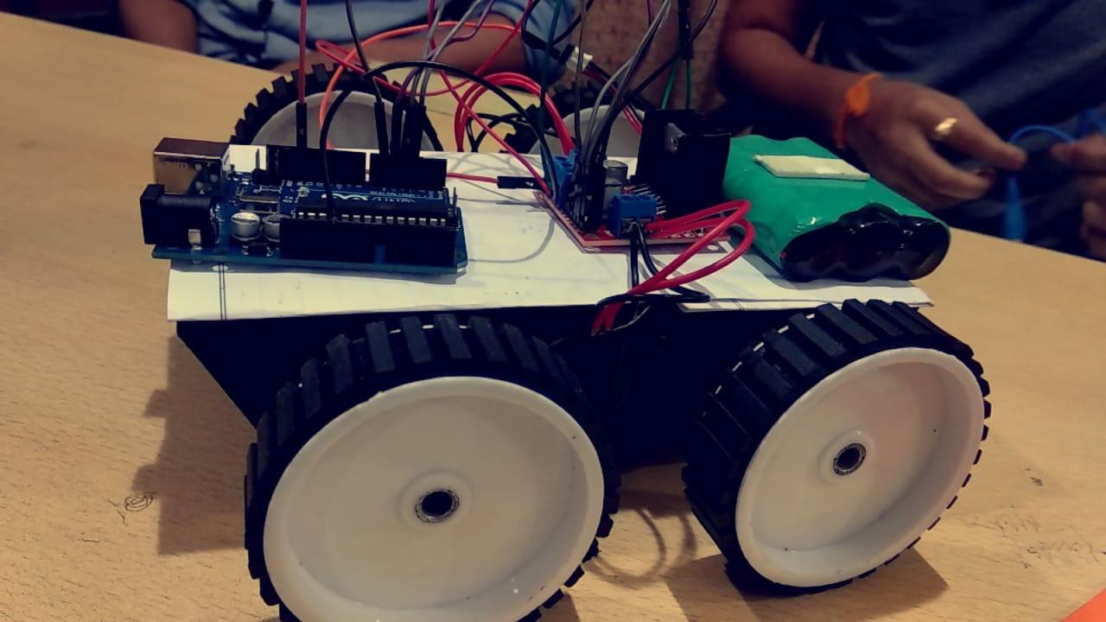
voice-rover voice CONTROLLED CAR

Slide 2
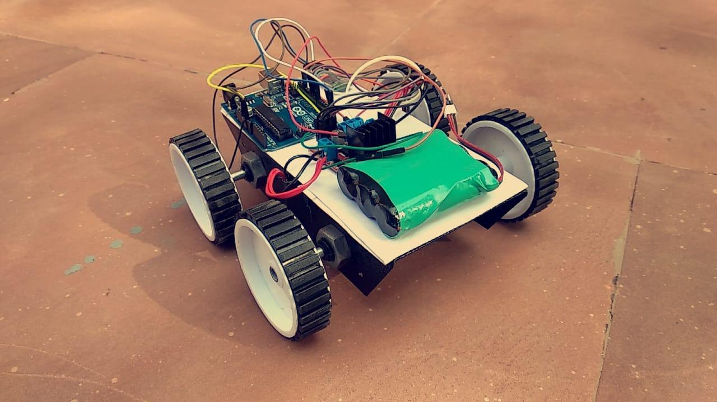

Slide 3
overview
INTRODUCTION
CIRCUIT DIAGRAM
HARDWARE REQUIREMENTS
SOFTWARE AND APPLICATIONS USED
APPLICATIONS

Slide 4
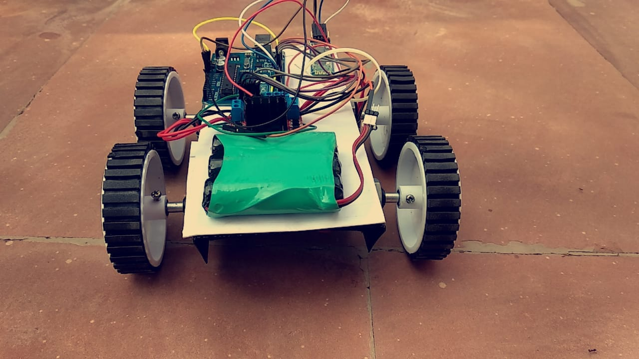
introduction
The project purposes the use of an Arduino Uno based project to CONTROL a CAR via VOICE COMMANDS through SMARTPHONE.
CAR runs in forward, backward , right & left on VOICE COMMANDS.

Slide 5
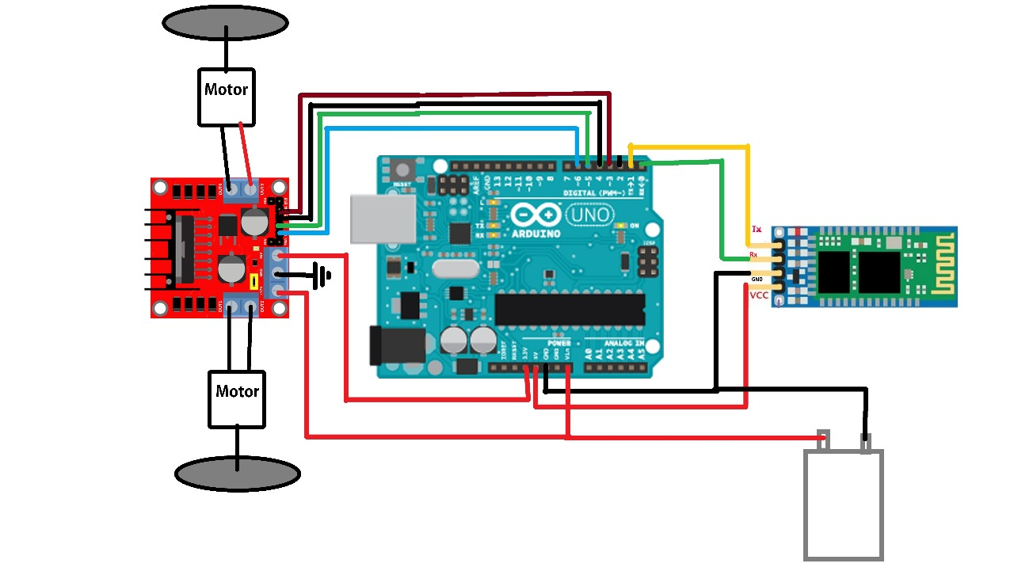
circuit diagram

Slide 6
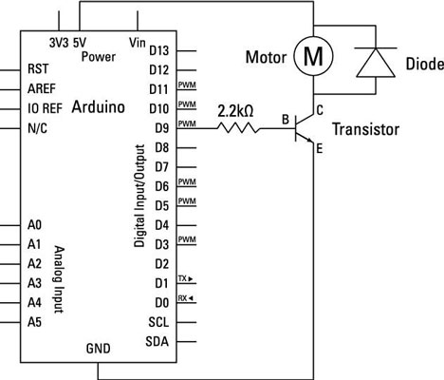
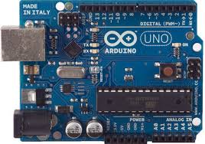
required components
ARDUINO UNO

Slide 7
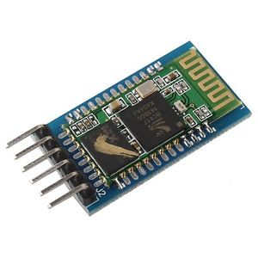
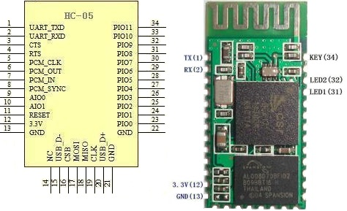
bluetooth module(hc-05)

Slide 8
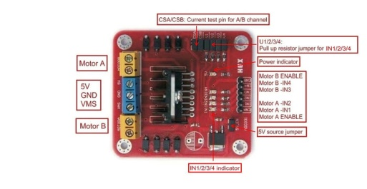
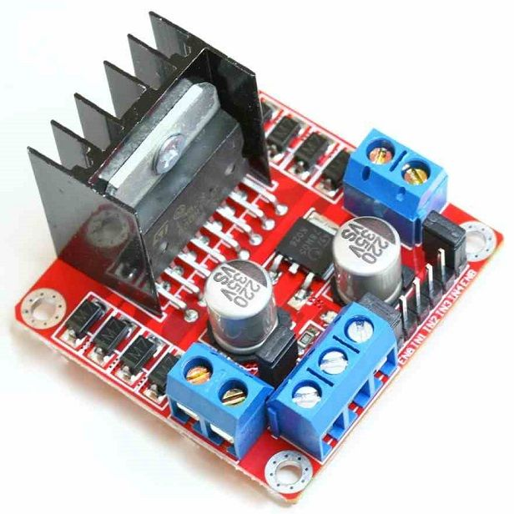
L298N MOTOR DRIVER

Slide 9
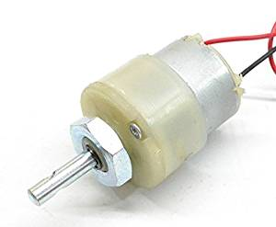
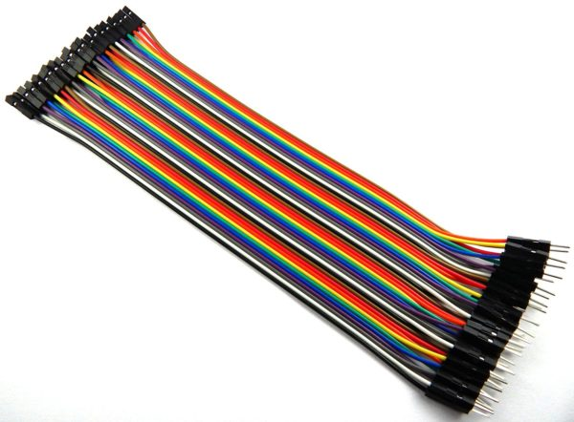
300 rpm dc motor
CONNECTING WIRES

Slide 10
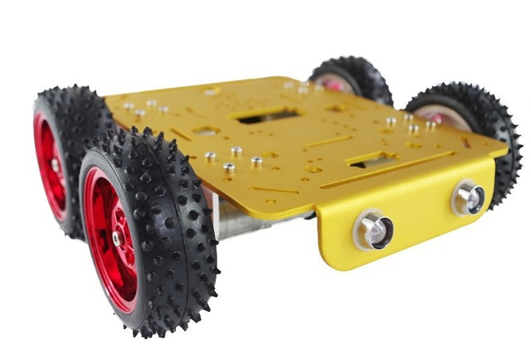
Wheels & chassis

Slide 11

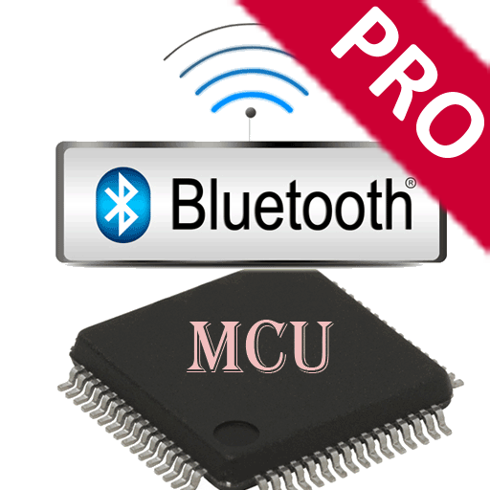
software & applications used
ARDUINO IDE
BLUETOOTH SPP PRO

Slide 12
applications
The Project Vehicle helps to control robot through voice commands and via android applications.
These vehicles are often used in places where its difficult for human to enter like MINE SEARCH ROBOT etc..
These vehicles can be controlled using sensors and controllers in many places such as INDUSTRIES , MILITARY etc.

Slide 13
Group members
PRAKHAR GUPTA
MANAS BATRA
ADITYA CHAUDHARY
RAHUL JAIN
SHUBHAM GUPTA
SUHANI SHARMA

Slide 14
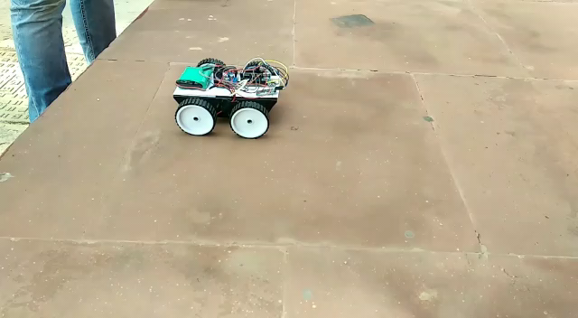
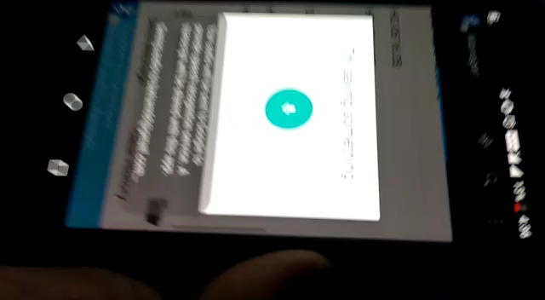
Glimpse of voice -rover

Slide 15


